Slide 1
collaborate-based recommendation system
Rec Systems

Slide 2
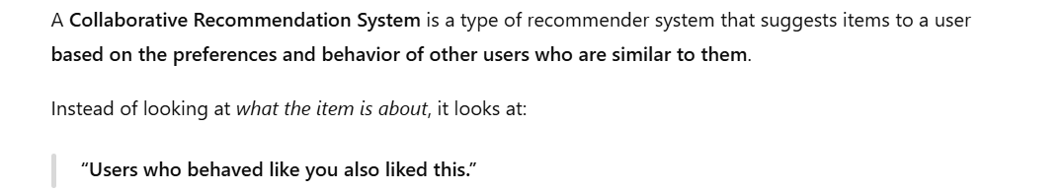

Slide 3
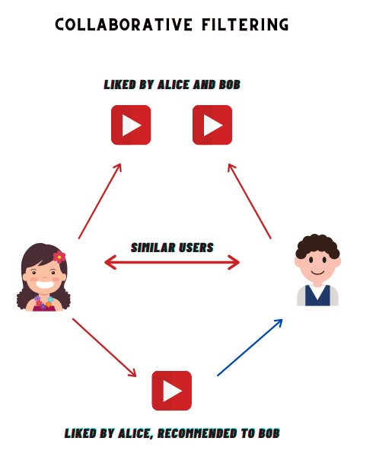

Slide 4
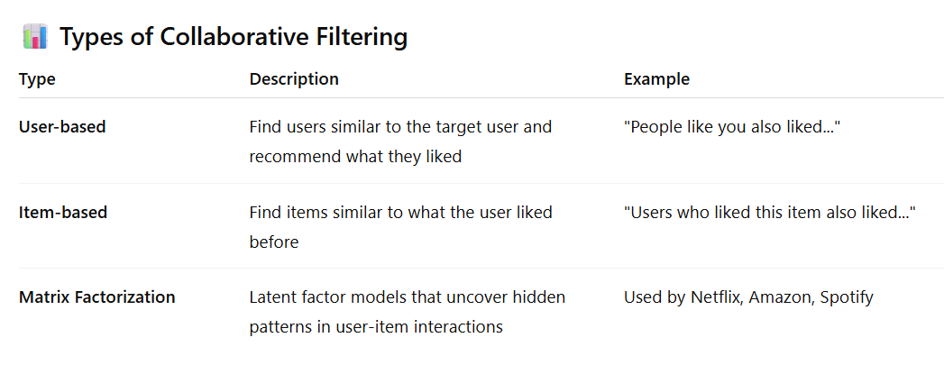

Slide 5
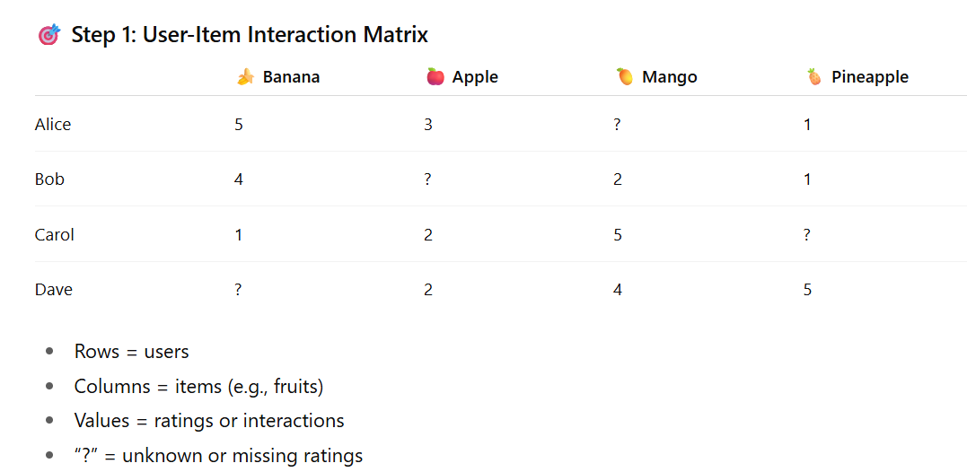

Slide 6
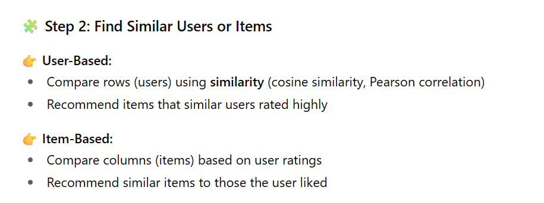

Slide 7
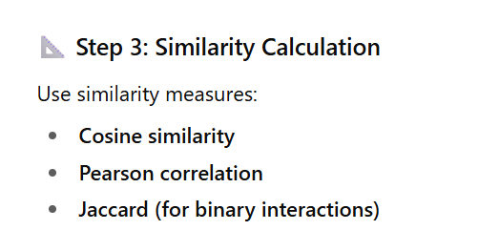

Slide 8
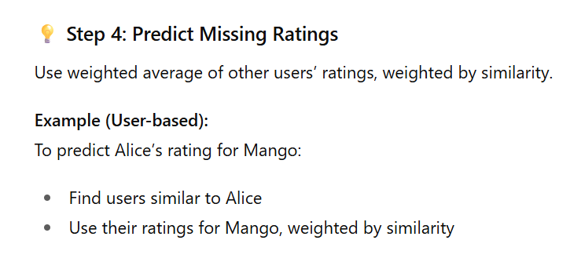

Slide 9
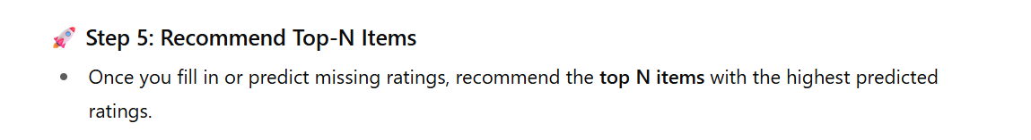

Slide 10
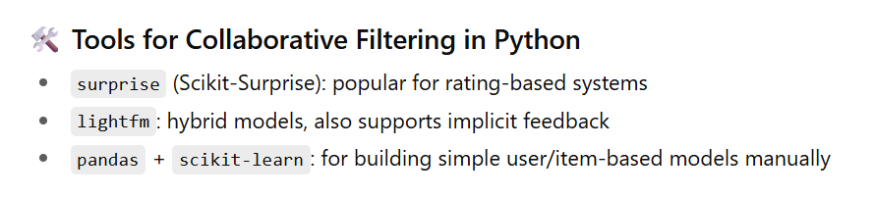

Slide 11
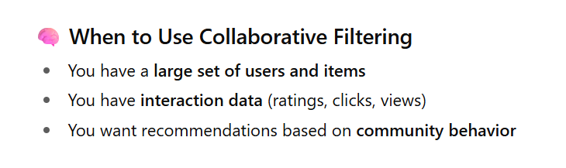

Slide 12
Feature | Content-Based | Collaborative Filtering
Based on | Item features | User behavior
Needs item metadata? | ✅ Yes | ❌ No
Cold start (new users) | ❌ Problematic | ✅ Needs user interaction first
Cold start (new items) | ✅ Easy to recommend | ❌ No user data yet
Personalized? | ✅ Yes | ✅ Yes

